Slide 1
Level Sensors (Ultrasonic)

Slide 2
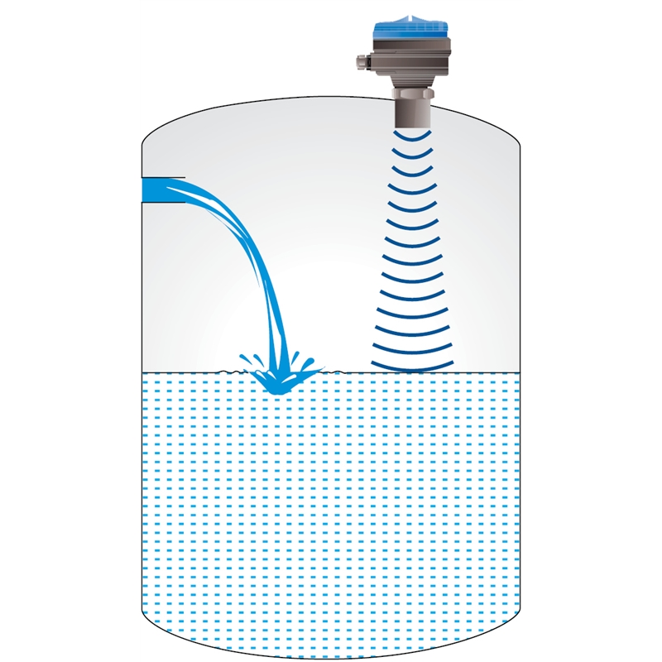
Ultrasonic Level Sensors

Slide 3
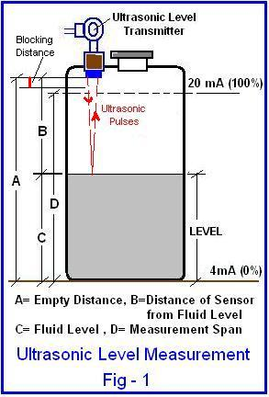
Ultrasonic Level Sensors

Slide 4
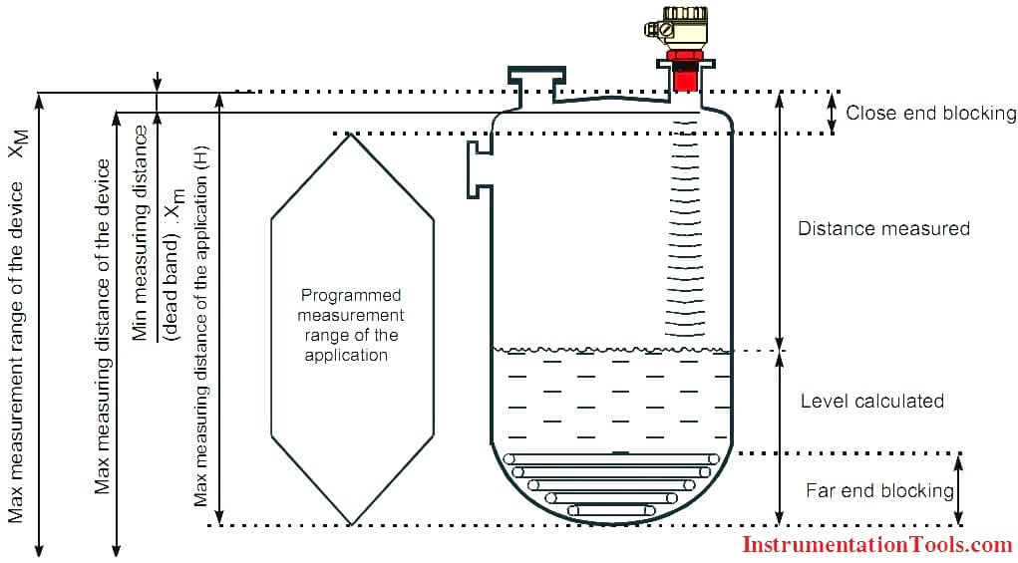
Ultrasonic Level Sensors

Slide 5
Ultrasonic Level Sensors
Ultrasonic level sensors use the Time-of-Flight measuring principle to measure level.
The device sends sound waves at a frequency higher than humans can hear, from 20 kilohertz to one gigahertz.
These waves bounce from the surface of the product, creating an echo that goes back to the sensor.
Then, the sensor calculates the time the echo took to return to find out the level.
It works in both: fluids and solids.

Slide 6
Ultrasonic Level Sensors
Air temperature can affect sound velocity and interfere with ultrasonic measurements.
The space between the ultrasonic level sensor and liquid must be at a uniform temperature to give you accurate data.
The material you want to measure with the ultrasonic level transmitter must have a certain density to reflect ultrasonic waves.
Sound travels faster through the air than through solids and liquids, so a significant difference in density between the air and your product results in a good signal.
The ultrasonic level sensor has a blocking distance where it can’t read properly, so you must include that in your calculations.
The readings are deflected due to foaming.
Obstructions in tanks can cause multiple and false reflections.
Ultrasonic level measurements get affected by the presence of vapor or steam above the measuring surface.
Vacuum applications are also not possible with an Ultrasonic level transmitter.

Slide 7
Ultrasonic Level Sensors(Advantages)
Non-contact, maintenance-free measurement
Measurement unaffected by media properties, like dc value or density
Calibration without filling or discharging
Self-cleaning effect due to vibrating sensor diaphragm

Slide 8
Level Sensors (Capacitive)

Slide 9
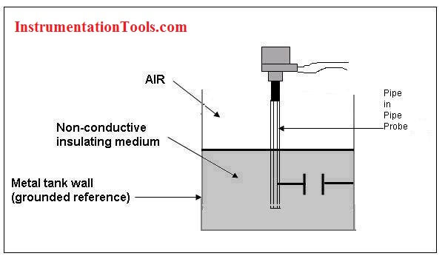
Capacitive Level Sensors.

Slide 10
Capacitive Level Sensors
Capacitance level sensors are used for wide variety of solids, aqueous and organic liquids, and slurries.
The technique is frequently referred as RF as radio frequency signals applied to the capacitance circuit.
The sensors can be designed to sense material with dielectric constants as low as 1.1 (coke and fly ash) and as high as 88 (water) or more.
Sludges and slurries such as dehydrated cake and sewage slurry (dielectric constant approx. 50) and liquid chemicals such as quicklime (dielectric constant approx. 90) can also be sensed.
Dual-probe capacitance level sensors can also be used to sense the interface between two immiscible liquids with substantially different dielectric constants.
Since capacitance level sensors are electronic devices, phase modulation and the use of higher frequencies makes the sensor suitable for applications in which dielectric constants are similar.

Slide 11
Capacitive Level Sensors(Working Principle)
The principle of capacitive level measurement is based on change of capacitance.
An insulated electrode acts as one plate of capacitor and the tank wall (or reference electrode in a non-metallic vessel) acts as the other plate.
The capacitance depends on the fluid level. An empty tank has a lower capacitance while a filled tank has a higher capacitance.
A simple capacitor consists of two electrode plate separated by a small thickness of an insulator such as solid, liquid, gas, or vacuum.
This insulator is also called as dielectric.
Value of C depends on dielectric used, area of the plate and also distance between the plates.

Slide 12
Capacitive Level Sensors(Measurement)
Where:
C = capacitance in picofarads (pF)
E = a constant known as the absolute permittivity of free space
K = relative dielectric constant of the insulating material
A = effective area of the conductors
d = distance between the conductors

Slide 13
Capacitive Level Sensors(Measurement)
Measurement is made by applying an RF signal between the conductive probe and the vessel wall.
The RF signal results in a very low current flow through the dielectric process material in the tank from the probe to the vessel wall. When the level in the tank drops, the dielectric constant drops causing a drop in the capacitance reading and a minute drop in current flow.
This change is detected by the level switch’s internal circuitry and translated into a change in the relay state of the level switch in case of point level detection.
In the case of continuous level detectors, the output is not a relay state, but a scaled analog signal.
Level Measurement can be divided into three categories:
Measurement of non-conductive material
Measurement of conductive material
Non-contact measurement

Slide 14
Capacitive Level Sensors(Measurement)
Non-conducting material:
For measuring level of non conducting liquids, bare probe arrangement is used as liquid resistance is sufficiently high to make it dielectric. Since the electrode and tank are fixed in place, the distance (d) is constant, capacitance is directly proportional to the level of the material acting as dielectric.
Conducting Material:
In conducting liquids, the probe plates are insulated using thin coating of glass or plastic to avoid short circuiting. The conductive material acts as the ground plate of the capacitor.
Proximity measurements (Non-contact type measurements):
In Proximity level measurement is the area of the capacitance plates is fixed, but distance between plates varies.

Slide 15
Capacitive Level Sensors(Advantages)
Relatively inexpensive
Versatile
Reliable
Requires minimal maintenance
Contains no moving parts
Easy to install and can be adapted easily for different size of vessels
Good range of measurement, from few cm to about 100 m
Rugged
Simple to use
Easy to clean
Can be designed for high temperature and pressure applications

Slide 16
Capacitive Level Sensors(Measurement Applications)
Liquids
Powered and granular solids
Liquid metals at very high temperature
Liquefied gases at very low temperature
Corrosive materials like hydrofluoric acid
Very high pressure industrial processes.

Slide 17
Capacitive Level Sensors(Measurement Applications)
Liquids
Powered and granular solids
Liquid metals at very high temperature
Liquefied gases at very low temperature
Corrosive materials like hydrofluoric acid
Very high pressure industrial processes.

